Slide 1

HOME | LOCATIONS | CATALOGUE | CONTACT US
ACCOUNT
DRIVE LIKE A MILLIONAIRE !
LUXURY CARS FOR RENT

Slide 2
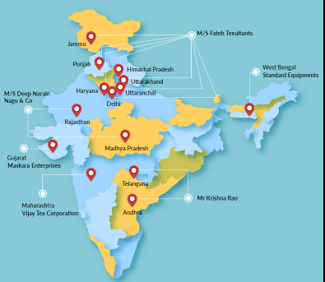
Search

Slide 3
BMW
AUDI
FERRARI
ASTON MARTIN
LAMBO

Slide 4
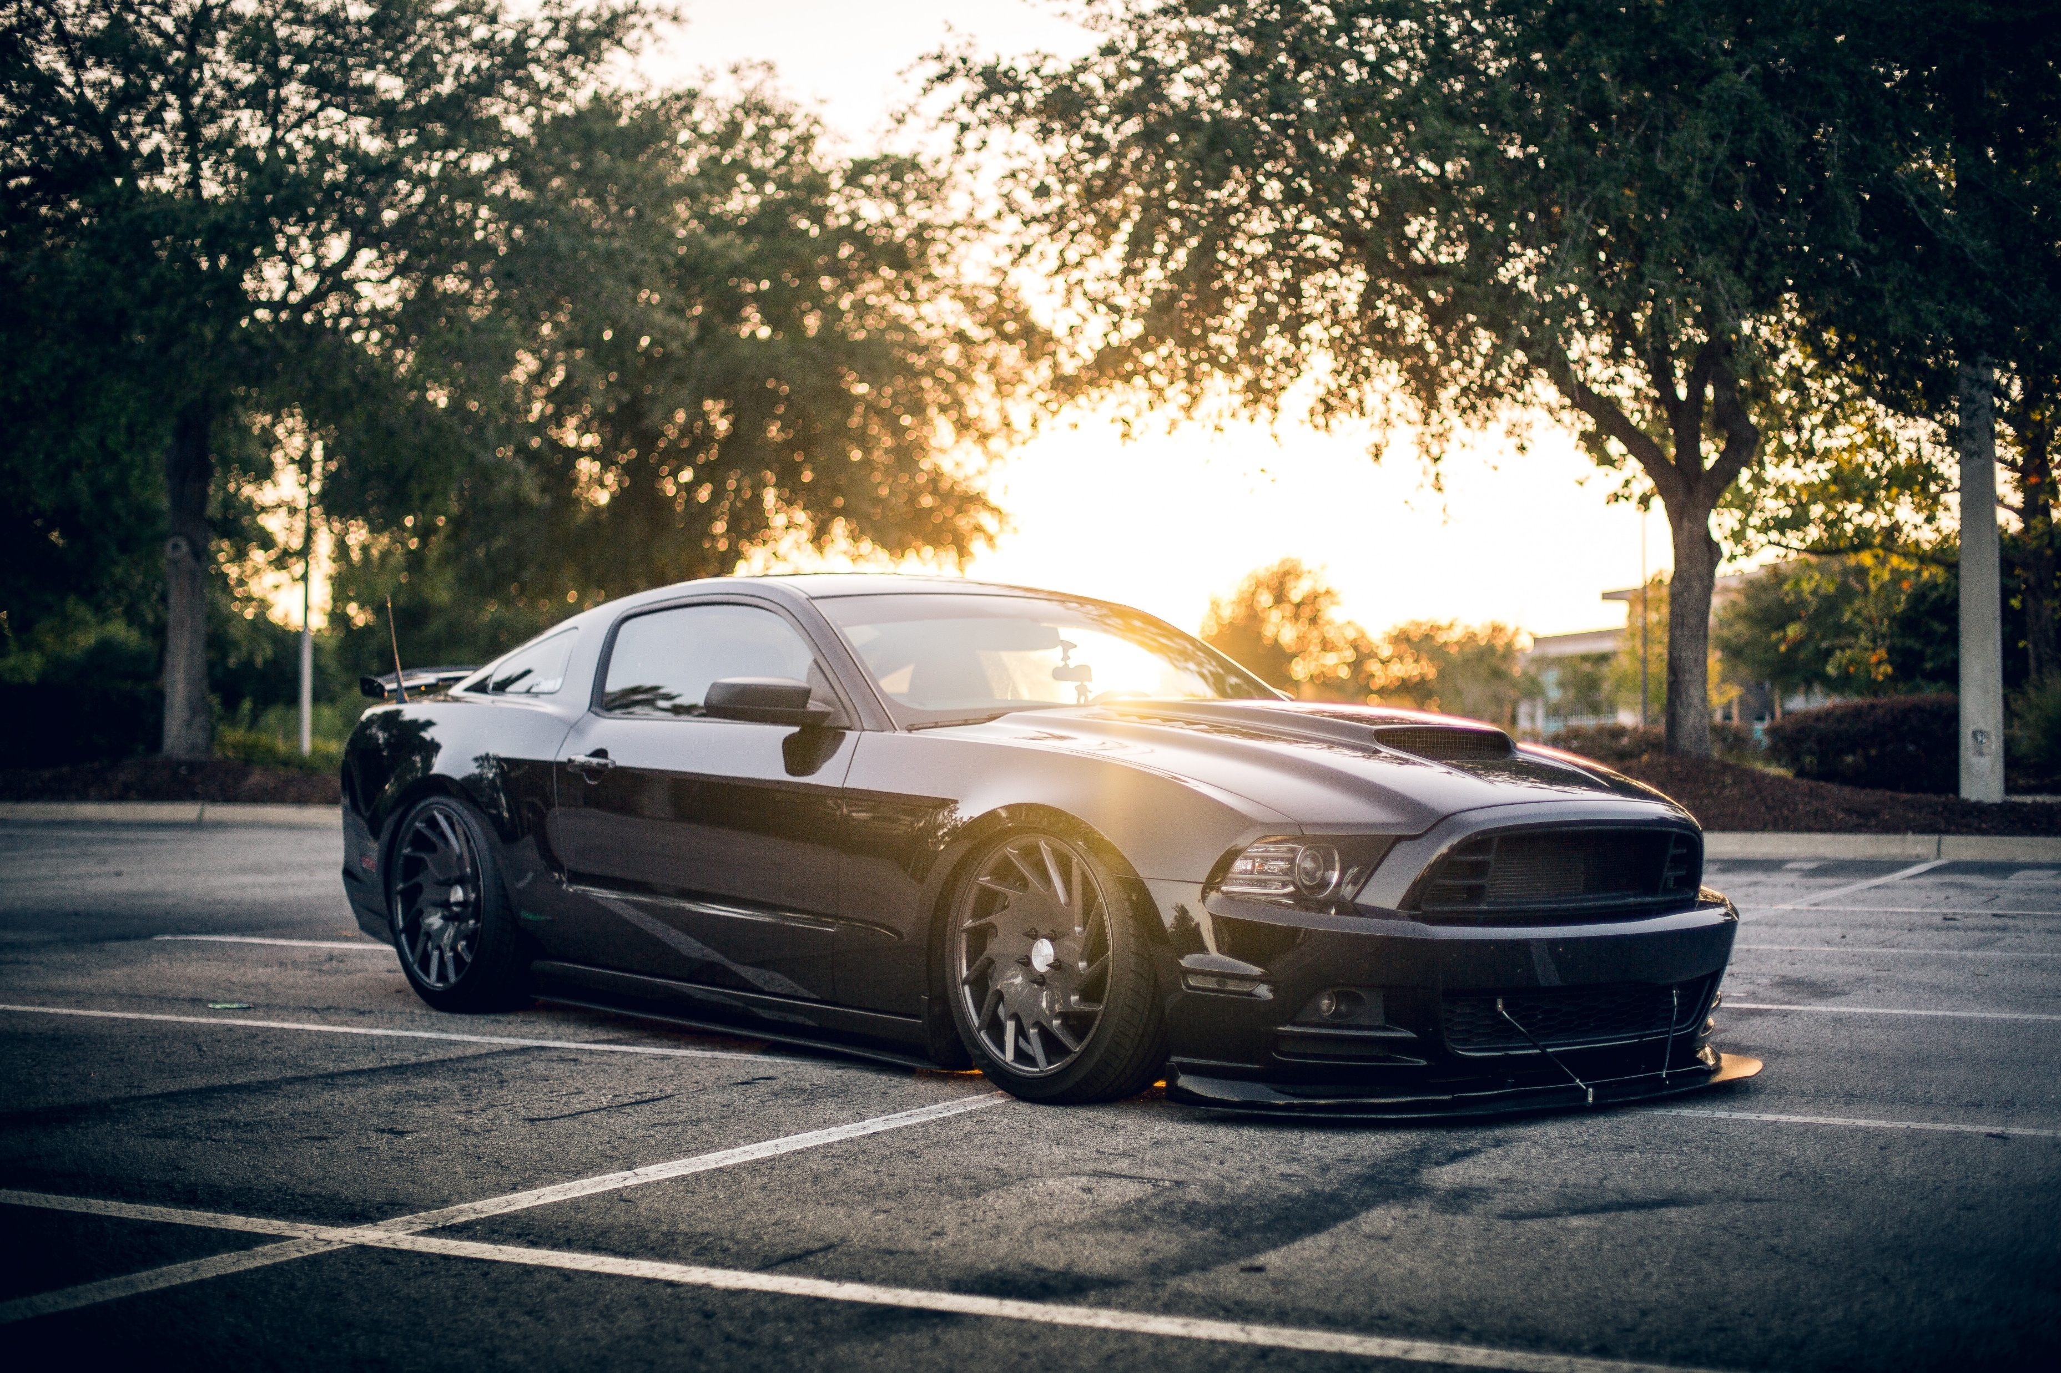
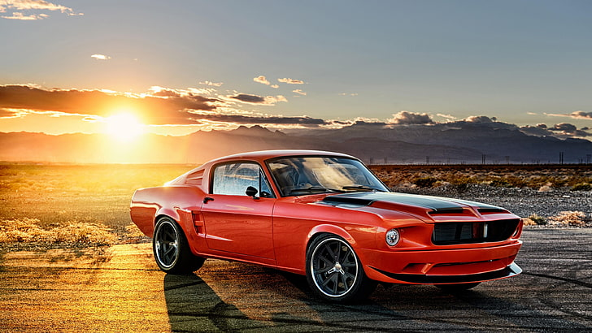
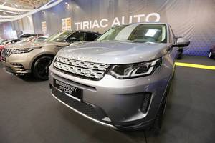

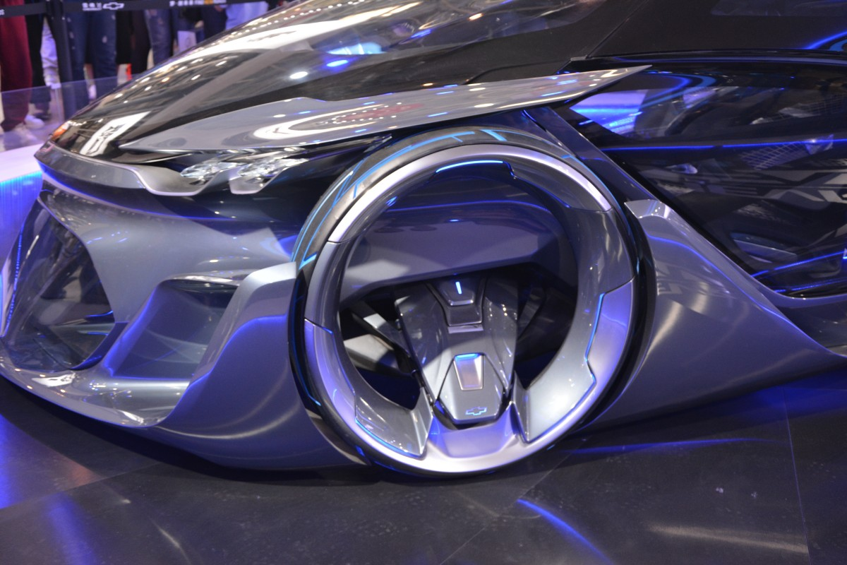
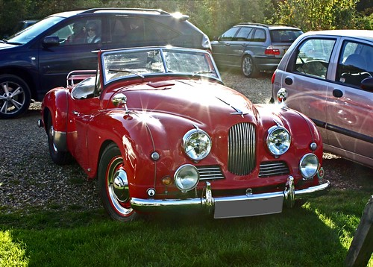


Prices Starting for
This Photo by Unknown Author is licensed under CC BY
This Photo by Unknown Author is licensed under CC BY
This Photo by Unknown Author is licensed under CC BY

Slide 5
CONTACT US
Address
Car
Address

